Slide 1
Modeling outputs

Slide 2
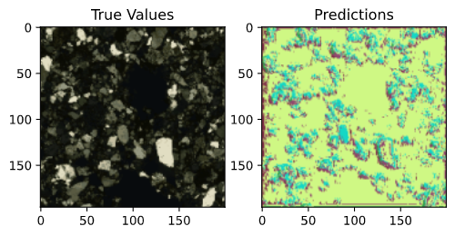
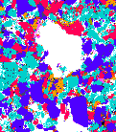
1 epoch, trained on just xpl images 150x150px
Loss: 10.65 – accuracy: 0.12
Notes:
img_input = tf.keras.Input(shape=(imshape))
# define encoder layers
# conv1 and conv2 contain intermediate the encoder outputs
# which will be used by the decoder
# pool2 is the final output of the encoder
# two convolution layers and one pooling layer, which downsamples image by a factor of 2
conv1 = tf.keras.layers.Conv2D(32, (3, 3), activation='relu', padding='same')(img_input)
conv1 = tf.keras.layers.Dropout(0.2)(conv1)
conv1 = tf.keras.layers.Conv2D(32, (3,3), activation='relu', padding='same')(conv1)
pool1 = tf.keras.layers.MaxPooling2D((2,2))(conv1)
conv2 = tf.keras.layers.Conv2D(64, (3,3), activation='relu', padding='same')(pool1)
conv2 = tf.keras.layers.Dropout(0.2)(conv2)
conv2 = tf.keras.layers.Conv2D(64, (3,3), activation='relu', padding='same')(conv2)
pool2 = tf.keras.layers.MaxPooling2D((2,2))(conv2)
# decoder layers
conv3 = tf.keras.layers.Conv2D(128, (3,3), activation='relu', padding='same')(pool2)
conv3 = tf.keras.layers.Dropout(0.2)(conv3)
conv3 = tf.keras.layers.Conv2D(128, (3,3), activation='relu', padding='same')(conv3)
# concat intermediate encoder outputs with intermediate decoder outputs, which is the skip connection
up1 = tf.keras.layers.concatenate([tf.keras.layers.UpSampling2D((2,2))(conv3), conv2], axis=-1)
conv4 = tf.keras.layers.Conv2D(64, (3,3), activation='relu', padding='same')(up1)
conv4 = tf.keras.layers.Dropout(0.2)(conv4)
conv4 = tf.keras.layers.Conv2D(64, (3,3), activation='relu', padding='same')(conv4)
up2 = tf.keras.layers.concatenate([tf.keras.layers.UpSampling2D((2,2))(conv4), conv1], axis=-1)
conv5 = tf.keras.layers.Conv2D(32, (3,3), activation='relu', padding='same')(up2)
conv5 = tf.keras.layers.Dropout(0.2)(conv5)
conv5 = tf.keras.layers.Conv2D(32, (3,3), activation='relu', padding='same')(conv5)
# get output with proper number of classes
out = tf.keras.layers.Conv2D(n_classes, (1,1), padding='same')(conv5)

Slide 3
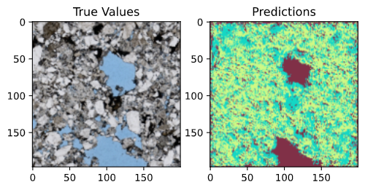
2 epoch, trained on just xpl images 150x150px
loss: 2.6517 - accuracy: 0.3143
Notes:
img_input = tf.keras.Input(shape=(imshape))
# define encoder layers
# conv1 and conv2 contain intermediate the encoder outputs
# which will be used by the decoder
# pool2 is the final output of the encoder
# two convolution layers and one pooling layer, which downsamples image by a factor of 2
conv1 = tf.keras.layers.Conv2D(32, (3, 3), activation='relu', padding='same')(img_input)
conv1 = tf.keras.layers.Dropout(0.2)(conv1)
conv1 = tf.keras.layers.Conv2D(32, (3,3), activation='relu', padding='same')(conv1)
pool1 = tf.keras.layers.MaxPooling2D((2,2))(conv1)
conv2 = tf.keras.layers.Conv2D(64, (3,3), activation='relu', padding='same')(pool1)
conv2 = tf.keras.layers.Dropout(0.2)(conv2)
conv2 = tf.keras.layers.Conv2D(64, (3,3), activation='relu', padding='same')(conv2)
pool2 = tf.keras.layers.MaxPooling2D((2,2))(conv2)
# decoder layers
conv3 = tf.keras.layers.Conv2D(128, (3,3), activation='relu', padding='same')(pool2)
conv3 = tf.keras.layers.Dropout(0.2)(conv3)
conv3 = tf.keras.layers.Conv2D(128, (3,3), activation='relu', padding='same')(conv3)
# concat intermediate encoder outputs with intermediate decoder outputs, which is the skip connection
up1 = tf.keras.layers.concatenate([tf.keras.layers.UpSampling2D((2,2))(conv3), conv2], axis=-1)
conv4 = tf.keras.layers.Conv2D(64, (3,3), activation='relu', padding='same')(up1)
conv4 = tf.keras.layers.Dropout(0.2)(conv4)
conv4 = tf.keras.layers.Conv2D(64, (3,3), activation='relu', padding='same')(conv4)
up2 = tf.keras.layers.concatenate([tf.keras.layers.UpSampling2D((2,2))(conv4), conv1], axis=-1)
conv5 = tf.keras.layers.Conv2D(32, (3,3), activation='relu', padding='same')(up2)
conv5 = tf.keras.layers.Dropout(0.2)(conv5)
conv5 = tf.keras.layers.Conv2D(32, (3,3), activation='relu', padding='same')(conv5)
# get output with proper number of classes
out = tf.keras.layers.Conv2D(n_classes, (1,1), padding='same')(conv5)

Slide 4
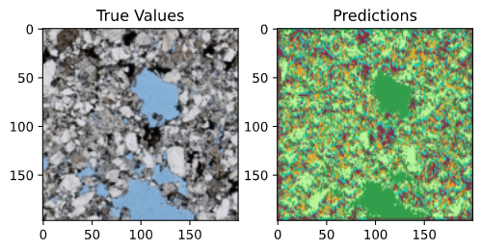
1 epoch, trained on just ppl images 150x150px
Loss: 8.97 – accuracy: 0.057
Notes:
img_input = tf.keras.Input(shape=(imshape))
# define encoder layers
# conv1 and conv2 contain intermediate the encoder outputs
# which will be used by the decoder
# pool2 is the final output of the encoder
# two convolution layers and one pooling layer, which downsamples image by a factor of 2
conv1 = tf.keras.layers.Conv2D(32, (3, 3), activation='relu', padding='same')(img_input)
conv1 = tf.keras.layers.Dropout(0.2)(conv1)
conv1 = tf.keras.layers.Conv2D(32, (3,3), activation='relu', padding='same')(conv1)
pool1 = tf.keras.layers.MaxPooling2D((2,2))(conv1)
conv2 = tf.keras.layers.Conv2D(64, (3,3), activation='relu', padding='same')(pool1)
conv2 = tf.keras.layers.Dropout(0.2)(conv2)
conv2 = tf.keras.layers.Conv2D(64, (3,3), activation='relu', padding='same')(conv2)
pool2 = tf.keras.layers.MaxPooling2D((2,2))(conv2)
# decoder layers
conv3 = tf.keras.layers.Conv2D(128, (3,3), activation='relu', padding='same')(pool2)
conv3 = tf.keras.layers.Dropout(0.2)(conv3)
conv3 = tf.keras.layers.Conv2D(128, (3,3), activation='relu', padding='same')(conv3)
# concat intermediate encoder outputs with intermediate decoder outputs, which is the skip connection
up1 = tf.keras.layers.concatenate([tf.keras.layers.UpSampling2D((2,2))(conv3), conv2], axis=-1)
conv4 = tf.keras.layers.Conv2D(64, (3,3), activation='relu', padding='same')(up1)
conv4 = tf.keras.layers.Dropout(0.2)(conv4)
conv4 = tf.keras.layers.Conv2D(64, (3,3), activation='relu', padding='same')(conv4)
up2 = tf.keras.layers.concatenate([tf.keras.layers.UpSampling2D((2,2))(conv4), conv1], axis=-1)
conv5 = tf.keras.layers.Conv2D(32, (3,3), activation='relu', padding='same')(up2)
conv5 = tf.keras.layers.Dropout(0.2)(conv5)
conv5 = tf.keras.layers.Conv2D(32, (3,3), activation='relu', padding='same')(conv5)
# get output with proper number of classes
out = tf.keras.layers.Conv2D(n_classes, (1,1), padding='same')(conv5)

Slide 5
1 epoch, trained on just ppl images 150x150px
Loss: 8.97 – accuracy: 0.057
Mixed dataset of two thin section images, images with lots of empty values removed
Notes:
img_input = tf.keras.Input(shape=(imshape))
# define encoder layers
# conv1 and conv2 contain intermediate the encoder outputs
# which will be used by the decoder
# pool2 is the final output of the encoder
# two convolution layers and one pooling layer, which downsamples image by a factor of 2
conv1 = tf.keras.layers.Conv2D(32, (3, 3), activation='relu', padding='same')(img_input)
conv1 = tf.keras.layers.Dropout(0.2)(conv1)
conv1 = tf.keras.layers.Conv2D(32, (3,3), activation='relu', padding='same')(conv1)
pool1 = tf.keras.layers.MaxPooling2D((2,2))(conv1)
conv2 = tf.keras.layers.Conv2D(64, (3,3), activation='relu', padding='same')(pool1)
conv2 = tf.keras.layers.Dropout(0.2)(conv2)
conv2 = tf.keras.layers.Conv2D(64, (3,3), activation='relu', padding='same')(conv2)
pool2 = tf.keras.layers.MaxPooling2D((2,2))(conv2)
# decoder layers
conv3 = tf.keras.layers.Conv2D(128, (3,3), activation='relu', padding='same')(pool2)
conv3 = tf.keras.layers.Dropout(0.2)(conv3)
conv3 = tf.keras.layers.Conv2D(128, (3,3), activation='relu', padding='same')(conv3)
# concat intermediate encoder outputs with intermediate decoder outputs, which is the skip connection
up1 = tf.keras.layers.concatenate([tf.keras.layers.UpSampling2D((2,2))(conv3), conv2], axis=-1)
conv4 = tf.keras.layers.Conv2D(64, (3,3), activation='relu', padding='same')(up1)
conv4 = tf.keras.layers.Dropout(0.2)(conv4)
conv4 = tf.keras.layers.Conv2D(64, (3,3), activation='relu', padding='same')(conv4)
up2 = tf.keras.layers.concatenate([tf.keras.layers.UpSampling2D((2,2))(conv4), conv1], axis=-1)
conv5 = tf.keras.layers.Conv2D(32, (3,3), activation='relu', padding='same')(up2)
conv5 = tf.keras.layers.Dropout(0.2)(conv5)
conv5 = tf.keras.layers.Conv2D(32, (3,3), activation='relu', padding='same')(conv5)
# get output with proper number of classes
out = tf.keras.layers.Conv2D(n_classes, (1,1), padding='same')(conv5)

